Slide 1
ADVERTISING SALES PREDICATION
USING MACHINE LEARNING
NAME: N.Mahesh
COURSE: DATA SCIENCE

Slide 2

INTRODUCTION
Project Objective
Problem Statement
Data Description
Data Preprocessing
Exploratory Data Analysis
Feature Engineering
Model Building
Model Prediction
Conclusion

Slide 3

PROJECTIVE OBJECTIVE
Advertising plays an important role in increasing product sales.
Companies spend money on TV, Radio, and Newspaper advertisements.
This project uses Machine Learning to analyze advertising data and predict sales.
It helps businesses make better marketing decisions.

Slide 4
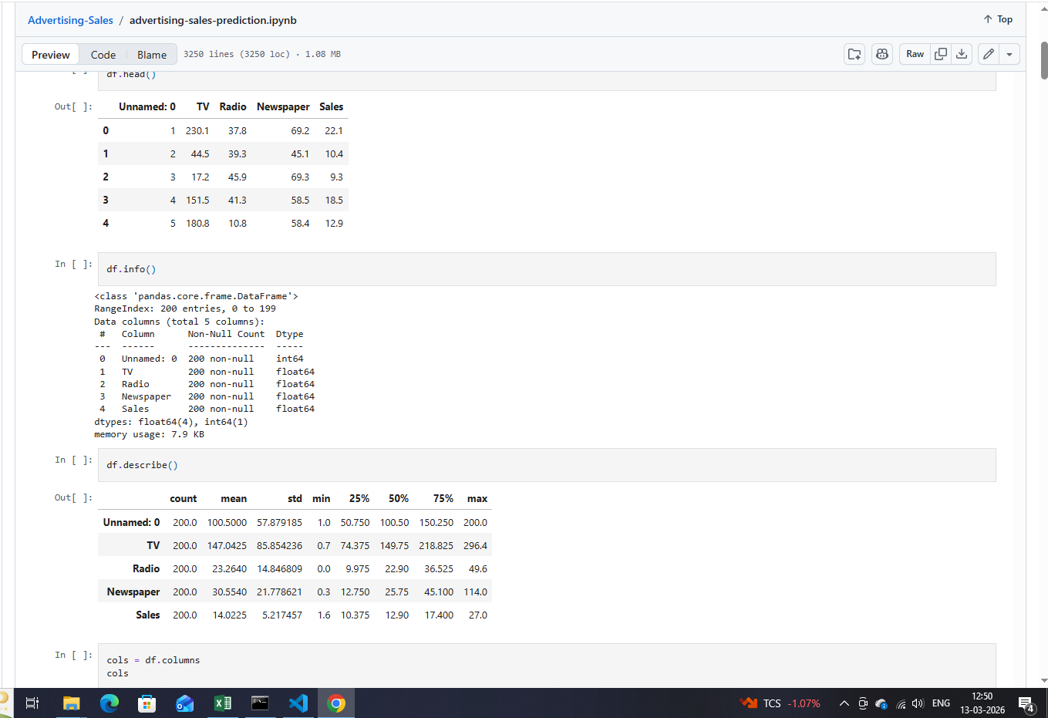
PROBLEM STATEMENT
Businesses want to know how advertising affects sales.
Manual analysis is difficult and time-consuming.
The goal of this project is to build a predictive model that
estimates sales based on advertising spending.

Slide 5
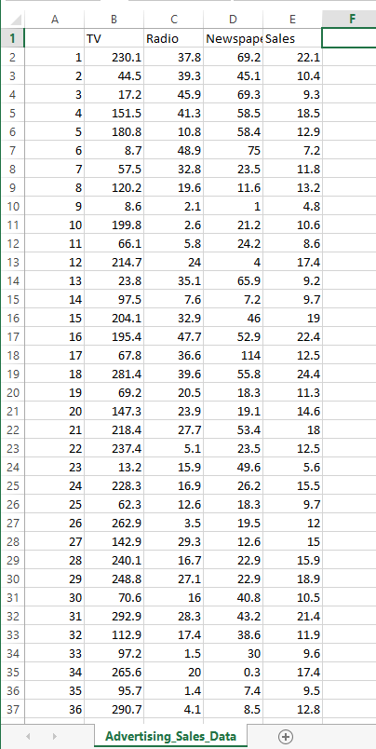
DATASET DESCRIPTION
The dataset contains advertising budgets in three media channels:
TV
Radio
Newspaper
Target variable: Sales
The dataset is used to train a machine learning model to predict sales.
From Excel file

Slide 6




DATA PRESROCESSING
Steps performed in this project:
Imported dataset using Pandas
Checked dataset structure using df.info()
Handled missing values.
Selected features and target variables
Prepared the dataset for model training.

Slide 7
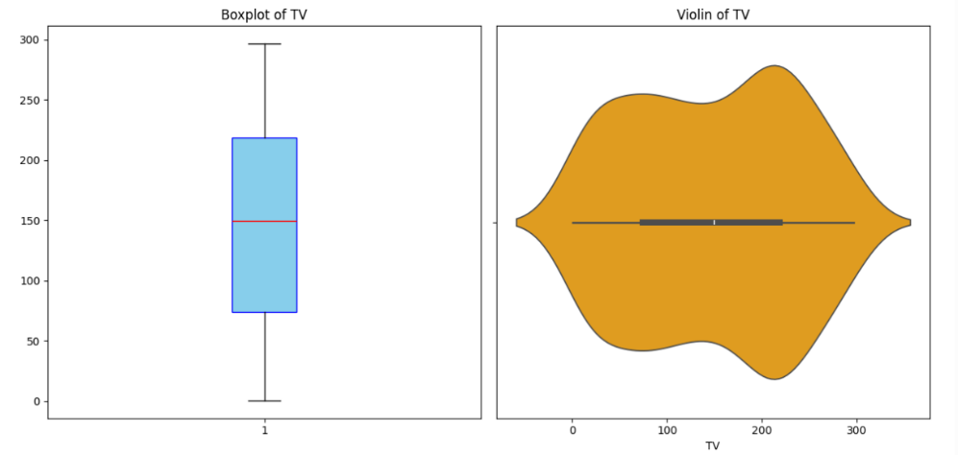
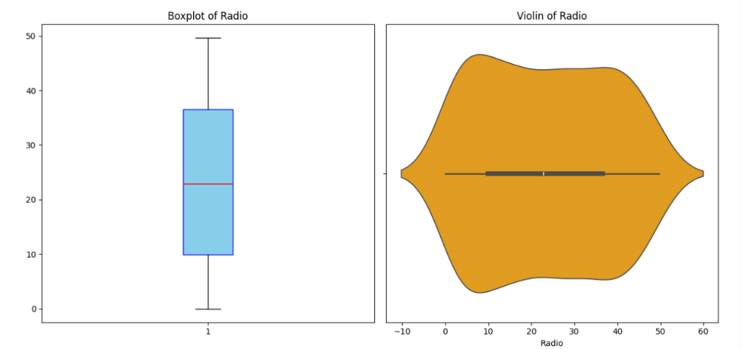
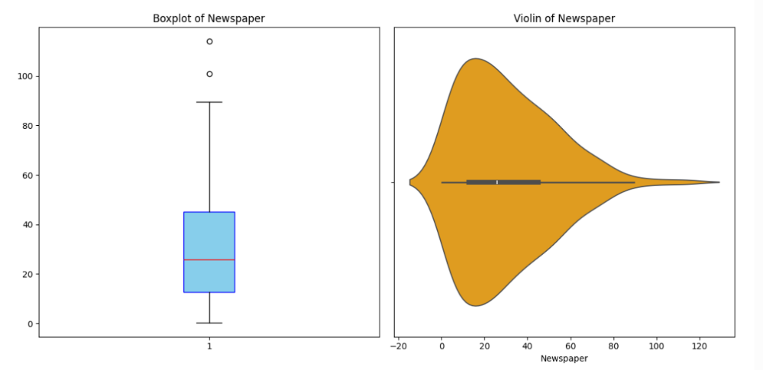
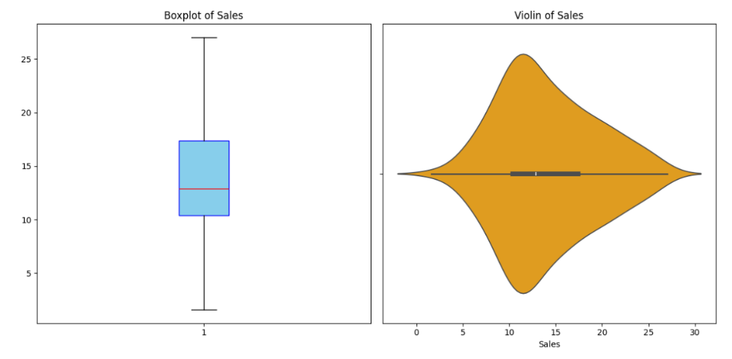
EXPLORATORY DATA ANALYSIS (EDA)
Data visualization was used to understand relationships.
Scatter plots were created between advertising budget and sales.
Correlation analysis helped identify which advertisement medium impacts sales more.

Slide 8

FEATURING ENGINEERING
Created a new feature to improve prediction accuracy.
Example: TV × Radio interaction feature.
This helps the model understand combined advertising effects.

Slide 9
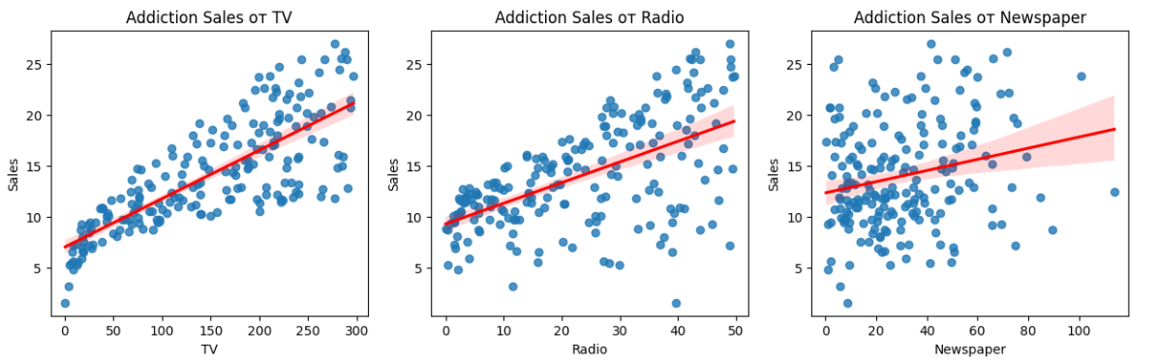
MODULE BUILDING
Algorithm Used: Linear Regression
Steps:
Split dataset into Training and Testing sets
Train the model using training data
Test model performance on unseen data.

Slide 10
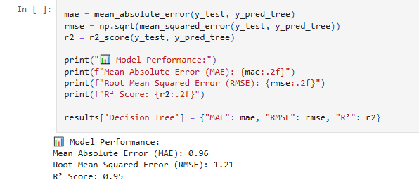
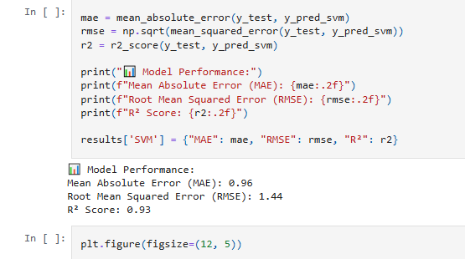
MODULE PREDICATION
Example prediction:
Input Advertising Budget:
TV = 150
Radio = 25
Newspaper = 20
The trained model predicts expected product sales based on these inputs

Slide 11
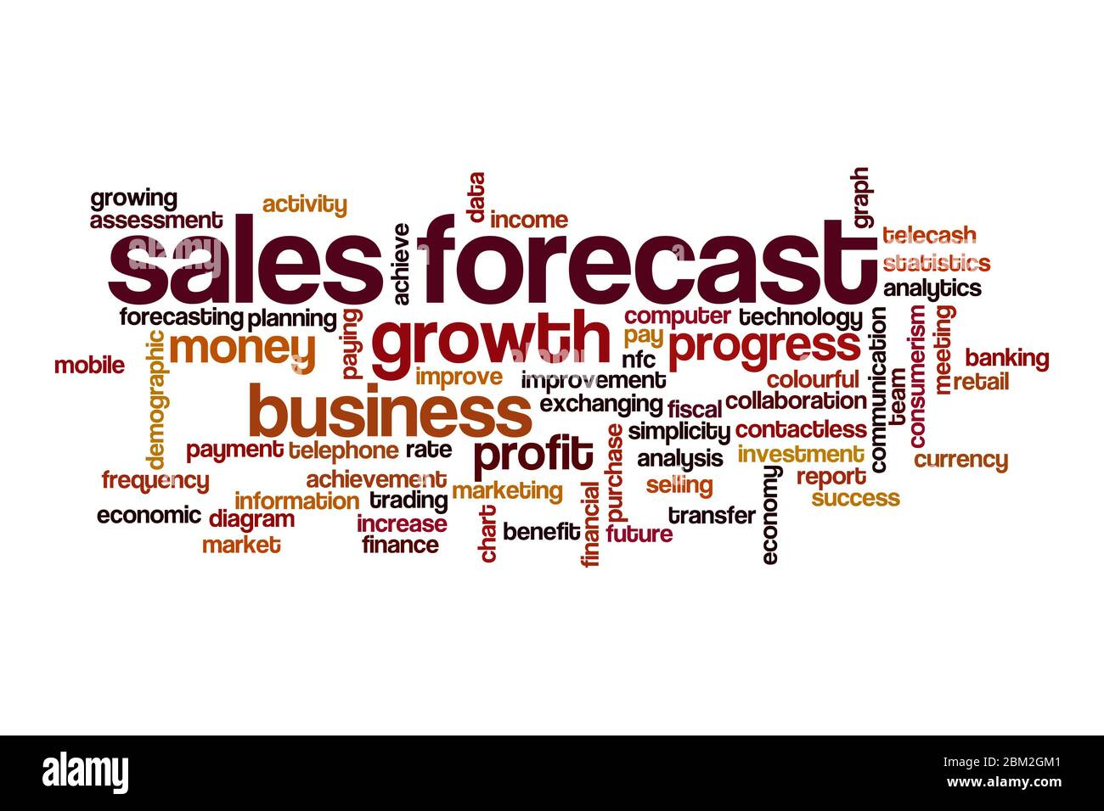
CONCLUSION
Machine Learning can effectively predict sales from advertising data.
TV and Radio advertising have a stronger influence on sales compared to Newspaper.
This model can help businesses optimize marketing budgets and improve decision making.

